Slide 1
TestNG

Slide 2
TestNG Framework
Automation testing framework in which NG stands for "Next Generation".
inspired from Junit which uses the annotations (@).
Advantages :
Generate the report in a proper format
Multiple test cases can be grouped more easily
Execute multiple test cases on multiple browsers
Easily integrated with tools like Maven, Jenkins
Generate the report in a readable format
Uncaught exceptions are automatically handled

Slide 3
Download & Install:
Launch Eclipse.
On the menu bar, click Help.
Choose the "Eclipse Marketplace..." option.
In the Eclipse Marketplace dialog box, type TestNG in the search box and press the search button( magnifying glass) or press enter key
Click Install
A new window for feature selection will open, Do not change anything and Click on confirm button

Slide 4
Click Next again on the succeeding dialog box until you reach the License Agreement dialog.
Click "I accept the terms of the license agreement" then click Finish.
If you encounter a Security warning, just click OK
When Eclipse prompts you for a restart, just click Yes
After the restart, verify if TestNG was indeed successfully installed

Slide 5
TestNG Annotations
@BeforeSuite: The annotated method will be run before all tests in this suite have run.
@AfterSuite: The annotated method will be run after all tests in this suite have run.
@BeforeTest: The annotated method will be run before any test method belonging to the classes inside the tag is run.
@AfterTest: The annotated method will be run after all the test methods belonging to the classes inside the tag have run.

Slide 6
@BeforeClass: The annotated method will be run before the first test method in the current class is invoked.
@AfterClass: The annotated method will be run after all the test methods in the current class have been run.
@BeforeMethod: The annotated method will be run before each test method.
@AfterMethod: The annotated method will be run after each test method.
@Test: The annotated method is a part of a test case

Slide 7
TestNG Groups
don't want to define test methods separately in different classes (depending upon functionality)
At the same time want to ignore (not to execute) some test cases as if they does not exist in the code
TestNG Groups are formed

Slide 8
In class file
@Test (groups = { "bonding", "strong" })
In Xml file
<groups>
<run>
<include name=“bonding" /> or
<exclude name=“strong" />
</run>
</groups>

Slide 9
TestNG @Test Priority
Without priority , TestNG tests run in alphabetical order
How to set priority In TestNG
@Test (priority=1)
Execution sequence:
First preference: Non-prioritized methods in alphabetical order
Second preference: Prioritized methods

Slide 10
Test Dependency
If one test needs to executed before other , you can use test dependency. Its achieved by
<include value=" TEST_CASE_NAME 1" dependsOnMethods=" TEST_CASE_NAME2 "/>
OR
@Test(dependsOnMethods={“TEST_CASE_NAME1"})

Slide 11
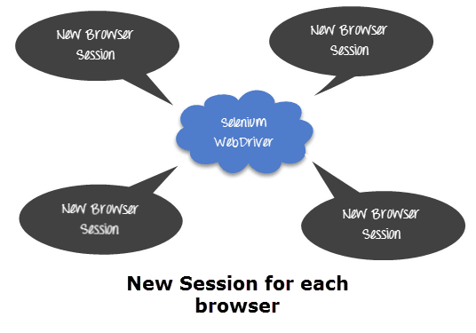
Session Handling
During test execution, the Selenium WebDriver has to interact with the browser all the time to execute given commands. At the time of execution, it is also possible that, before current execution completes, someone else starts execution of another script, in the same machine and in the same type of browser. To achieve this
<suite name="TestSuite" thread-count="3" parallel="methods" >

Slide 12
Parameterization using Dataprovider
To pass multiple data to the application at runtime, we need to parameterize our test scripts.
@Parameters annotation is easy but to test with multiple sets of data we need to use Data Provider
@Test(dataProvider="mydata")
@DataProvider
public Object[][] mydata() {
return new Object[][] {
new Object[] { “”, ””},
new Object[] {“” , ””},
};
}

Slide 13
Parameterization using XML
In the test, add annotation @Parameters
@Parameters ({"fname","lname"})
In the XML, in the Test tag
<parameter name="fname" value=“abc"></parameter>
<parameter name="lname" value=“xyz"></parameter>

Slide 14
Assert
Assertions verify that the state of the application is same to what we are expecting
Methods :
Assert.assertEquals(actual,expected);
Assert.assertEquals(actual,expected,message);

